Slide 1
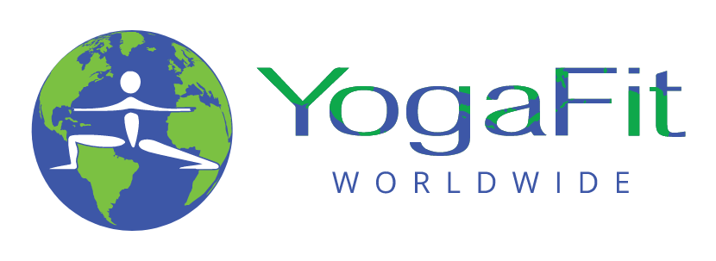
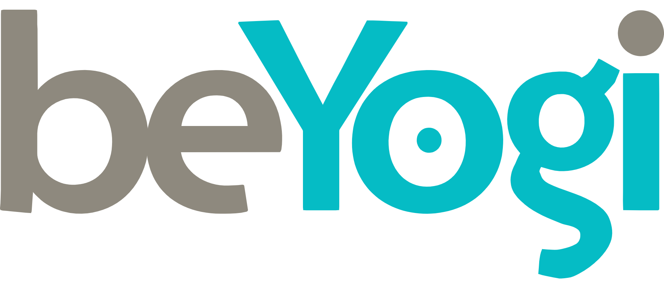
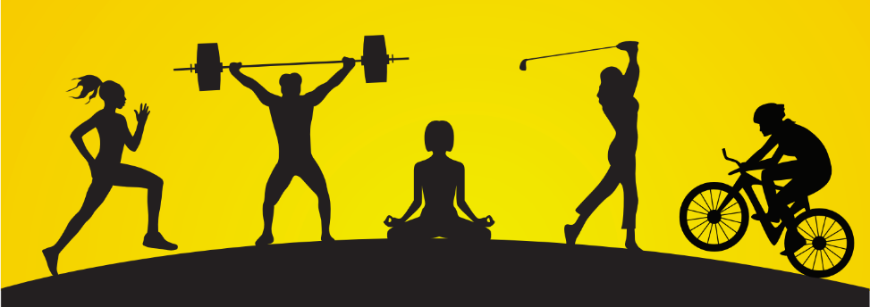
Yoga for Athletes
Renee Harrington
M.S. Exercise Science, E-RYT 500, Senior Master Trainer

Slide 2
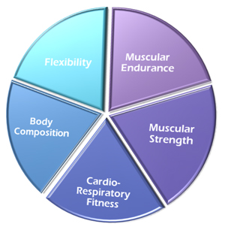
Yoga Provides Balance for the Athlete
5 Components of Fitness
Physical fitness is defined as "a set of attributes that people have or achieve that relates to the ability to perform physical activity”
Each aspect of physical fitness is important to health
You are only as strong as your weakest link

Slide 3
How would you draw your pie chart?
Cardiorespiratory
Fitness
Body
Composition
Flexibility
Muscular
Strength
Muscular
Endurance
Training effect is evident after 6 weeks of training; deconditioning effect within 2 weeks of inactivity.

Slide 4
Yoga Provides Balance for the Athlete

Slide 5
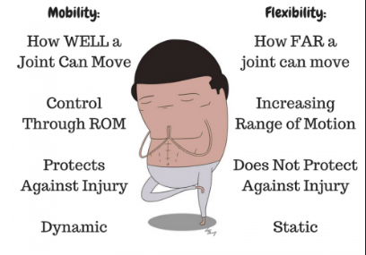
Yoga for Flexibility and Mobility
Yoga brings us into and through all planes of motion

Slide 6
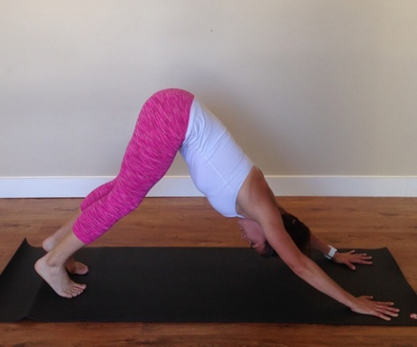
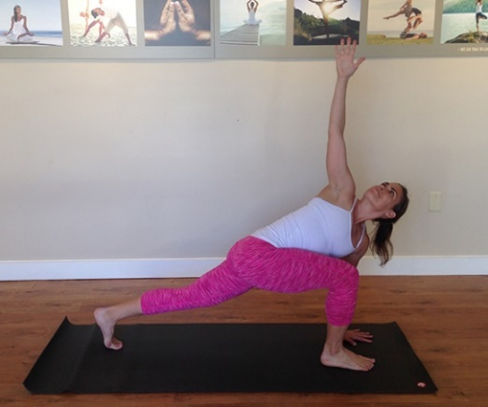
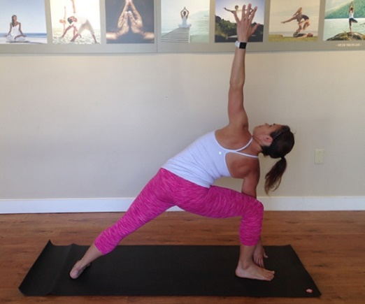
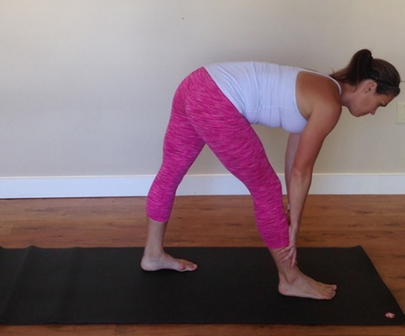
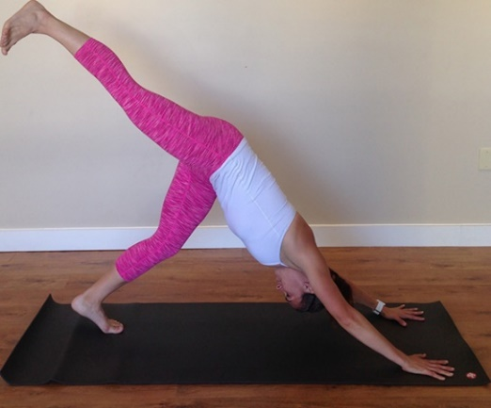
Multi-Directional Flow Sequence
Down Dog
Twisting Lunge
Side Angle
Pyramid
3-Legged Dog
Down Dog

Slide 7
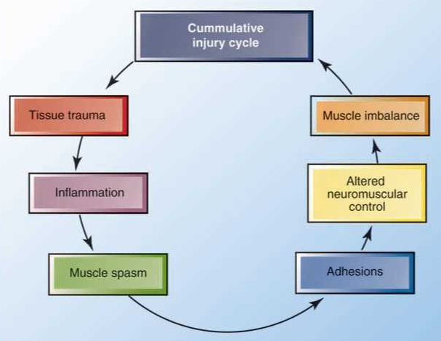
Yoga for Injury Prevention

Slide 8
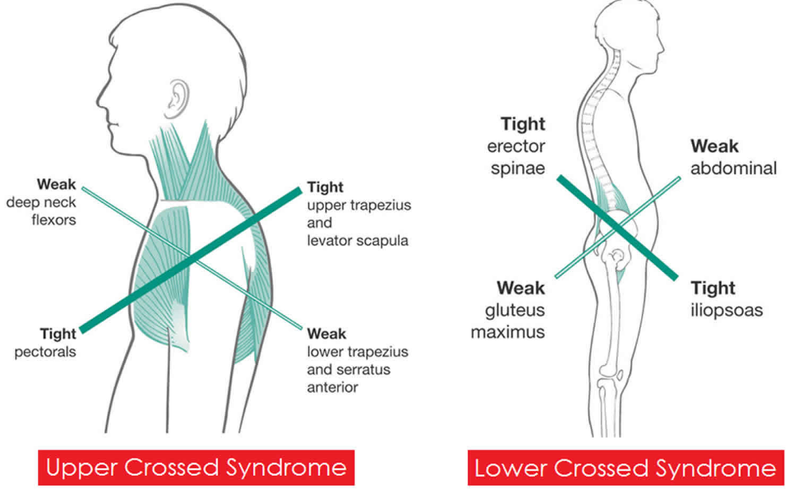
Muscle Imbalances in Athletes
Upper Crossed Syndrome: Over-/underactive muscles in neck, chest, shoulders;
Lower Crossed Syndrome: Over-/underactive muscles in low back, abs, glutes, hip flexors

Slide 9
Yoga Sequence for Muscle Imbalances
Chest expansion
Low lunge
Cat/cow
Triangle
Prayer twist lunge
Child’s pose
Locust
Bridge

Slide 10
Breath Practices for Athletes
The quality of breath will determine quality of performance
Improves aerobic capacity
Trains parasympathetic nervous system
Some are energizing, others are calming
Can use breath with visualization/meditation

Slide 11
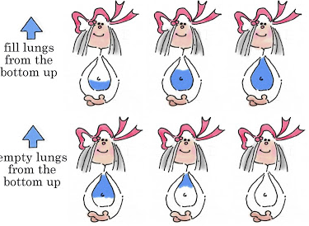
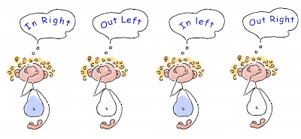
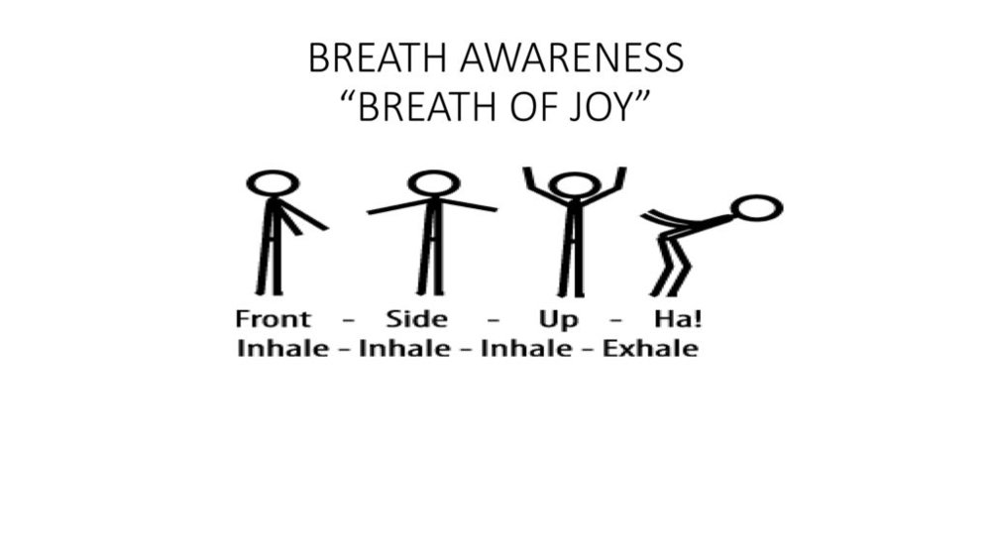
Breath Practices for Athletes
Diaphragmatic Breath
Alternate Nostril Breath
Breath of Joy

Slide 12
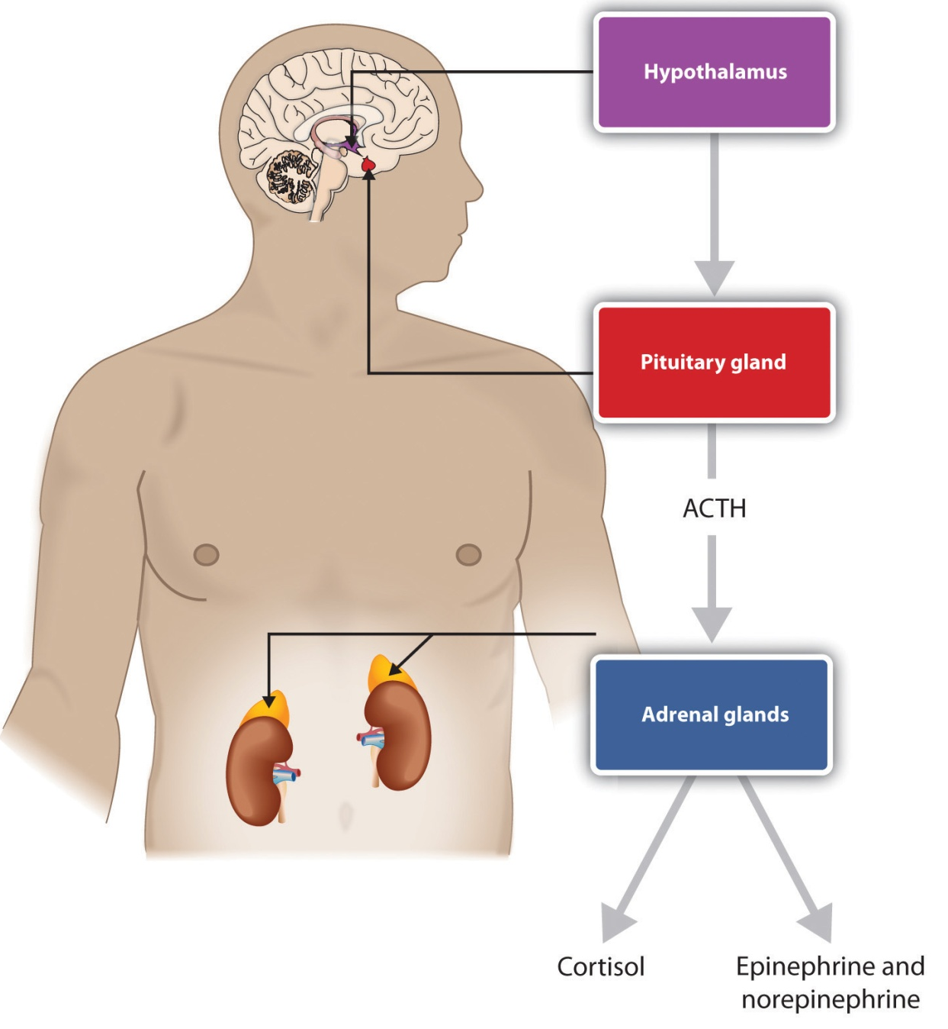
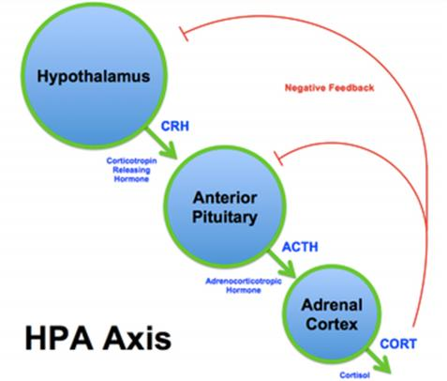
Exercise and Stress
Stress – HPA Axis can impact
Hypothalamus-Pituitary-Adrenal Axis
Neuroendocrine feedback loop
Release of hormones
Activated during stress

Slide 13
Cortisol Levels
Ideally cortisol is high in the morning and tapers off through the day and evening
Normally lowest around 3:00 am, begins to rise in early hours, and peaks around 8:00 am
When chronically stressed, the body releases cortisol at all hours which can lead to adrenal exhaustion
Other contributors:
sustained periods of inadequate sleep
general lack of physical and mental rest
too much caffeine
lack of proper diet

Slide 14
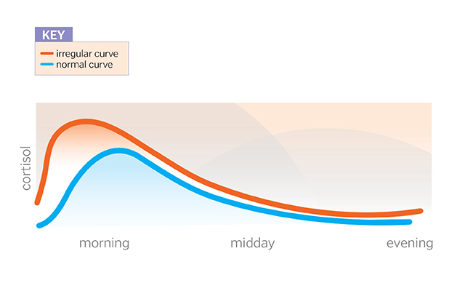
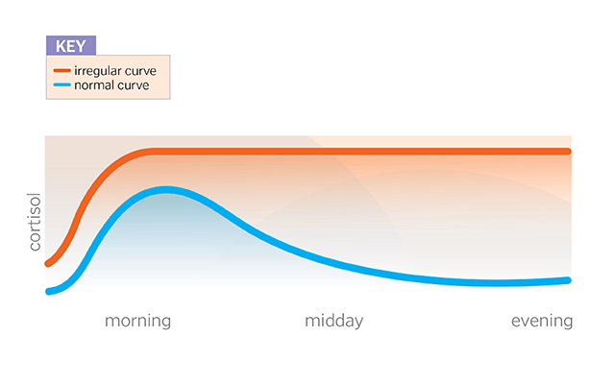
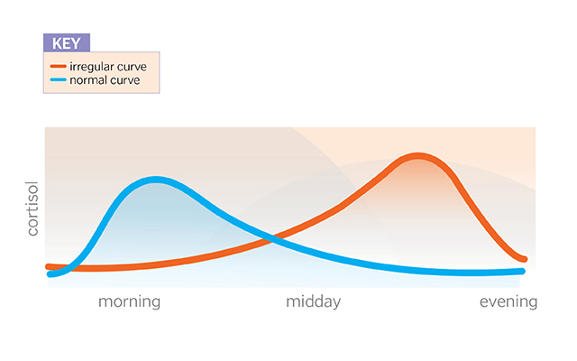
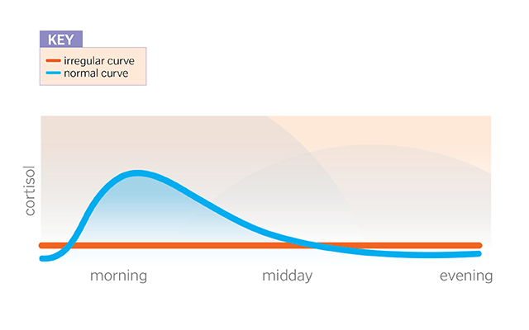
High Early-Morning Cortisol
High Cortisol Throughout the Day
High Evening Cortisol
Low Cortisol Throughout the Day

Slide 15
Healthy Cortisol Levels
Eat a Healthy Diet
Supplement Nutrition (if needed)
Stay Hydrated
Practice Relaxing
Time Your Workouts
Get Some Sleep
Cortisol and melatonin (hormone that regulates sleep cycles) work in tandem. When cortisol drops, melatonin takes over and makes you sleepy. When you’re asleep, relatively low levels of cortisol allow your cells to repair and heal. If cortisol levels stay elevated, your body can’t make those repairs and you wake up feeling fatigued.

Slide 16
Example Meditations for Athletes
10 minute breath meditation
https://drive.google.com/file/d/1YzTXKSRnwSSu-FnDdCX55rHGdgS_bRaS/view?usp=sharing
15 minute body scan
https://drive.google.com/file/d/1sDqeUT1X62u0Hz6oyDxjqHFOKyhY_RM3/view?usp=sharing
25 minute Yoga Nidra
https://drive.google.com/file/d/0B1eHjCfNO8qPS3JfM3Atb2pkbVE/view
Sun salutations as a moving meditation
https://drive.google.com/file/d/1CulBBmU25sA6ujyi3cjxyVUXTbLuQp0_/view

Slide 17
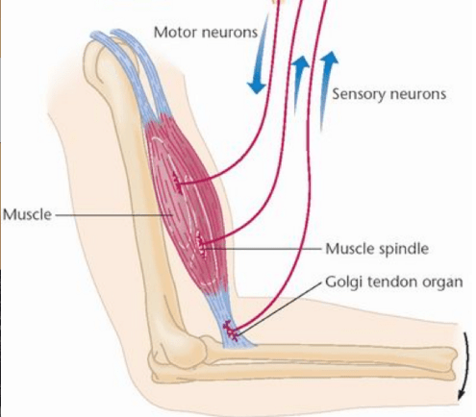
Muscle Proprioceptors
Muscle Spindles
Within belly of muscle, detects changes in length
Excitatory impulse sent back
Muscle fibers contracts to protect muscle from tearing or overstretching
Golgi Tendon Organs
Muscle-tendon junction, detects change in pressure
Inhibitory impulse sent back
Muscle relaxes in response which creates “slack” in the muscle

Slide 18
Proprioceptive Neuromuscular Facilitation
Temporary contraction of the target muscle in order to stimulate the GTO. GTO signals the muscle to relax
Steps:
Set length – point where brain recognizes end of stretch
Gently contract – 20% for 2-3 breaths (5-10 sec)
Relax for one deep breath
Go deeper – contract opposite muscle to take up “slack”
Complete 2-3 cycles
Advanced stretching techniques - https://drive.google.com/file/d/1FT9wOVmF7pP0RkliOHGQx8CXCUfIvw69/view?usp=sharing

Slide 19
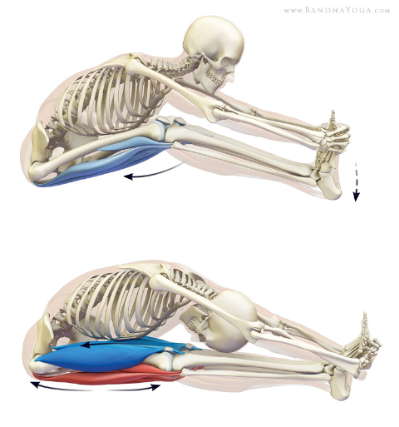
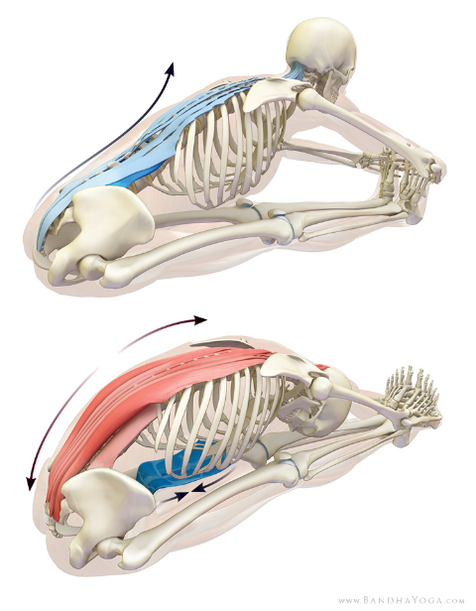
Proprioceptive Neuromuscular Facilitation
Slightly bend the knees and squeeze the trunk against the thighs. Then gently press the heels into the mat as if you are trying to flex the knees further. This engages the hamstrings.
Bend forward to stretch the back muscles. Hold the stretch by bending the arms, then attempt to arch the back activating the erector spinae and quadratus lumborum.

